Slide 1
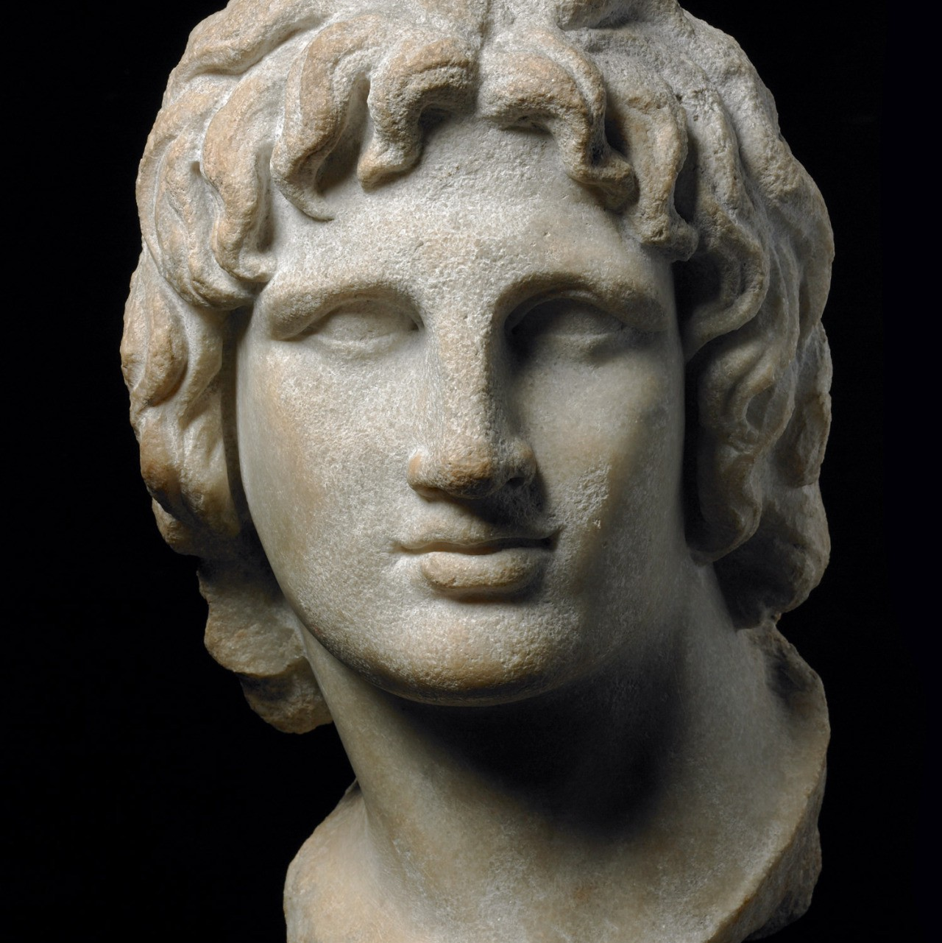
Continuing an aim - Persia
Year 11 Ancient History
Week 2 – Lesson 2

Slide 2
Motivations
After Alexander came to the throne he executed those responsible for his father’s death and then decided to fulfil his father’s dream of conquering Peria in revenge for their invasion of Greece 150 years before, though first he had to quash the revolts in many Greek city-states.

Slide 3
Overview
Conquest of Persia took over 11 years
Army of 50,000 + Greeks and Macedonians
Travelled more than 30,000 kms
Methods:
Greek Phalanx
Mobile, lightly armed infantry and cavalry
Victory after victory BUT long and difficult campaign

Slide 4
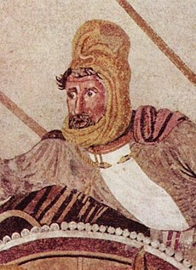
King Darius III
Last king of Achaemenid Empire of Persia
Ancient Iranian Empire
Stretched from borders of India down through Egypt and up to the Northern Borders of Greece
Dominant empire
Unstable but STRONG (resourced) empire
336BC – 330BC ruled

Slide 5
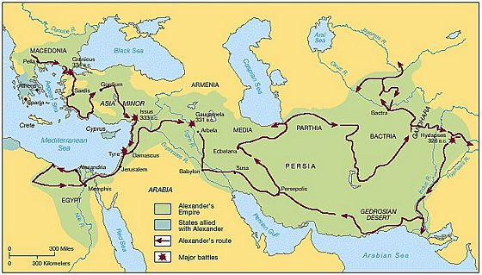

Slide 6
ACTIVITY
ACTIVITY
Read through the information sheet as a class.
Highlight using 3 different colours.
Answer the questions below.

Slide 7
Source Analysis
Read through each of the sources
Answer the following about each source:
Identify the MESSAGE of this source. ”The message of this source is...”
What does this teach you about Alexander the Great? How does it contribute to your understanding about him?

